Slide 1
William Beaven Portfolio Evidence

Slide 2
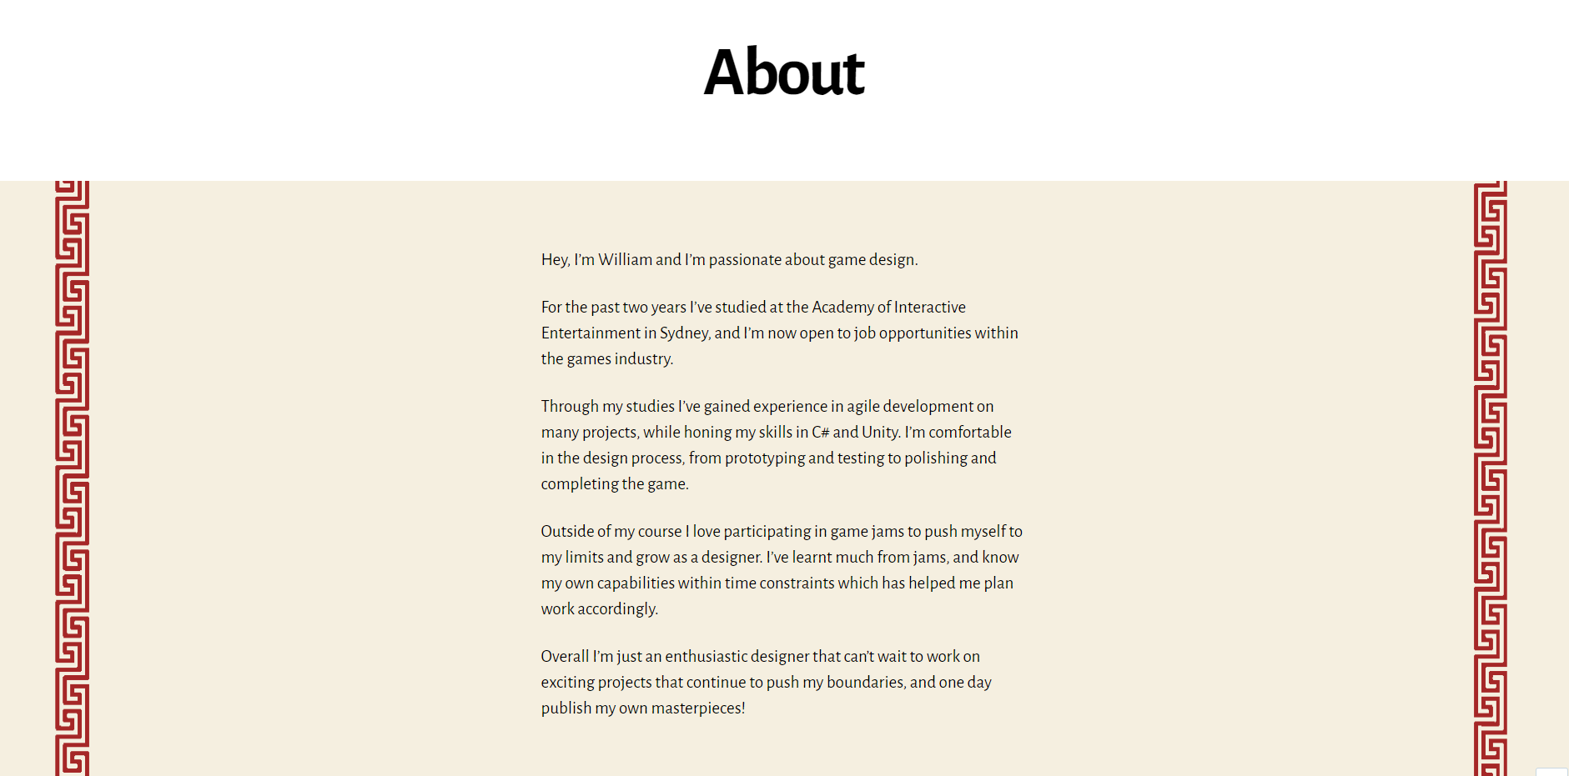

Slide 3
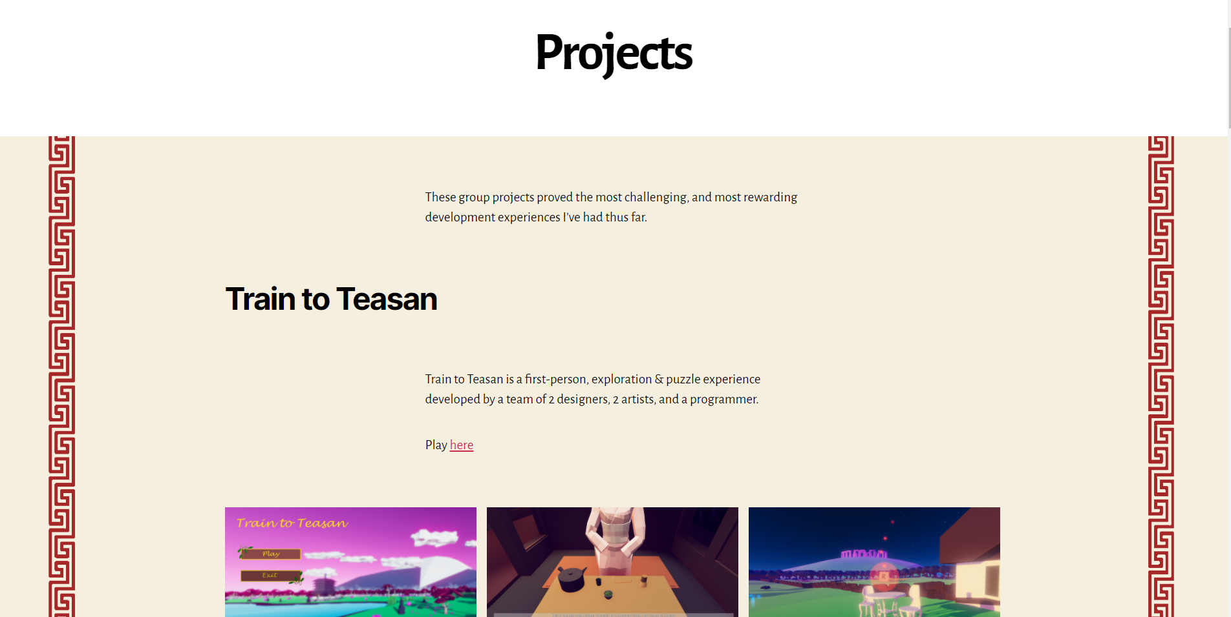

Slide 4
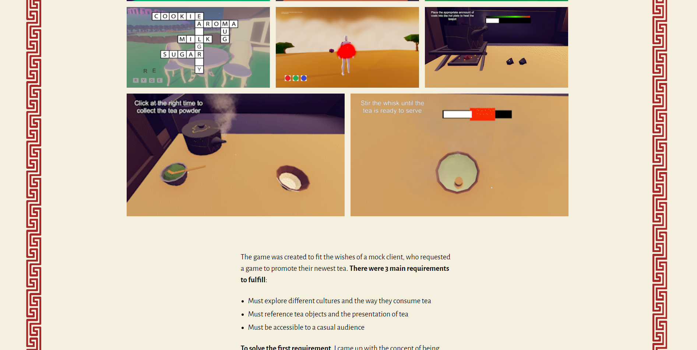

Slide 5
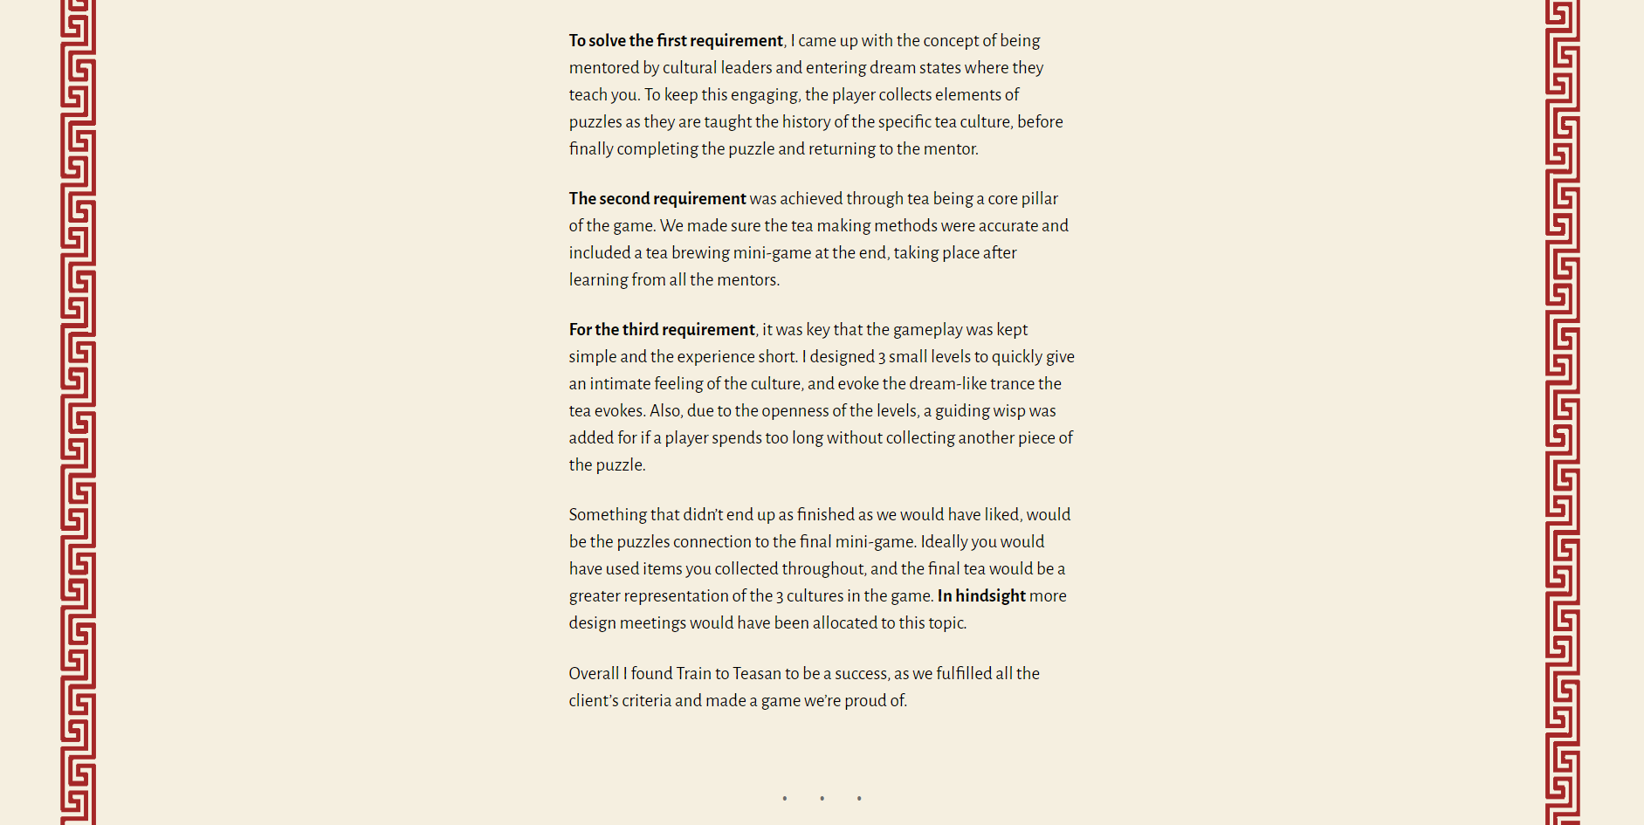

Slide 6
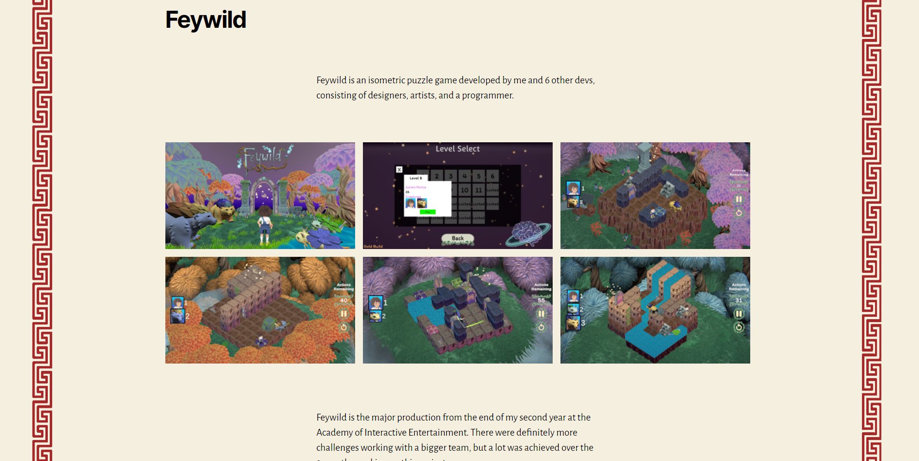

Slide 7
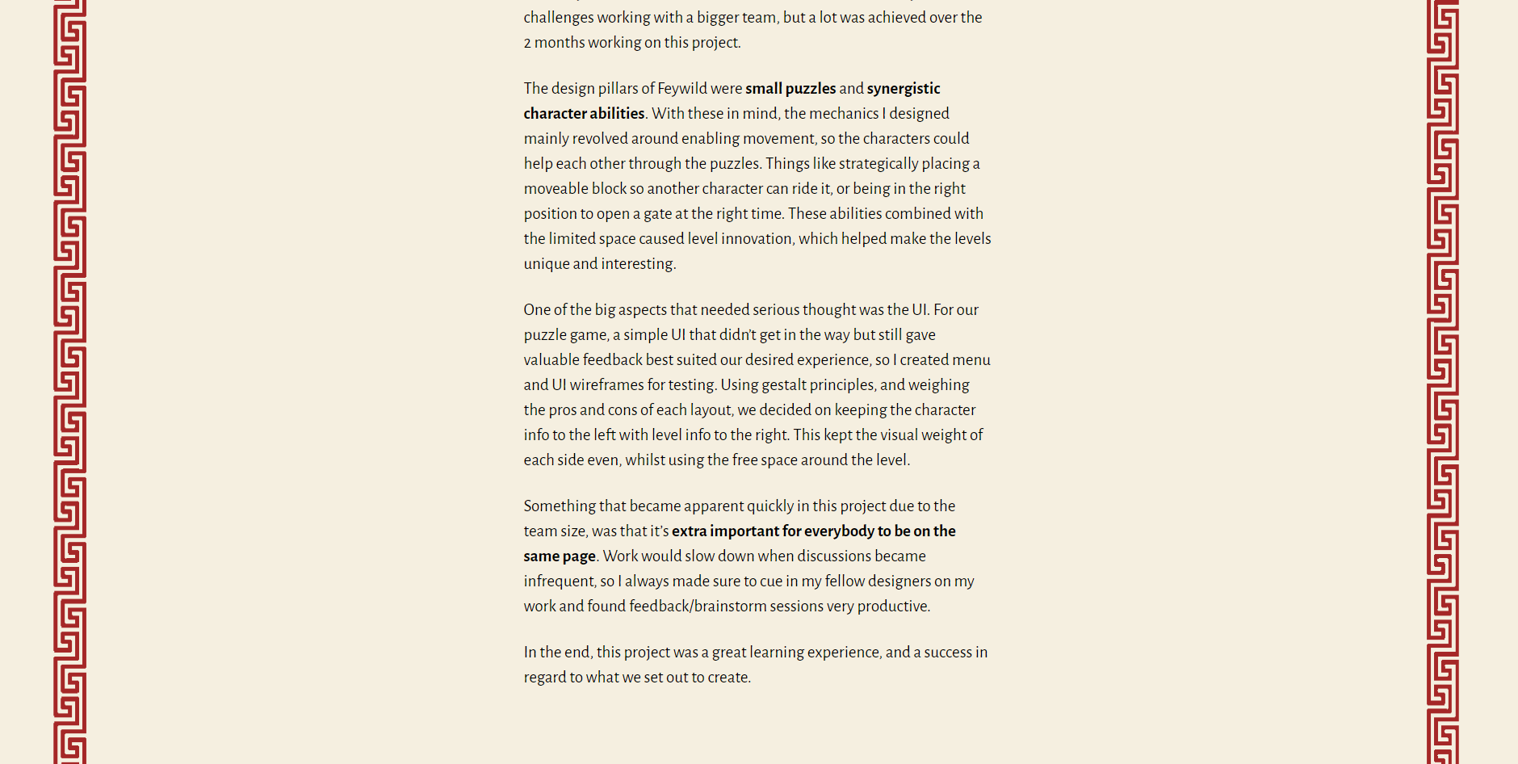

Slide 8
Portfolio Feedback
Supplier | Feedback | Response
Sebastian | Overview my role in projects | Added an overview segment at the top of each project

